Slide 1



GPS BASED LPG LEAKAGE NOTIFICATION SYSTEM
Guided By
Dr.C Nandagopal
Presented By
DINESH S (927623BEC049)
GOBIKRISHNAN A(927623BEC055)

Slide 2
INTRODUCTION
LPG is widely used in homes, hotels, and industries due to its efficiency and easy availability, but it is highly inflammable and can cause serious accidents if leakage goes undetected.
Traditional gas detection methods rely on human senses and manual checks, which are slow and unreliable, especially during emergencies.
To overcome this, an IoT-Based LPG Leakage Alert System with Real-Time GPS Tracking is proposed.
The system uses an MQ-2 gas sensor and ESP32 microcontroller to continuously monitor gas levels and trigger a buzzer, SMS, and call alerts through a GSM module when leakage exceeds safe limits, ensuring quick response and enhanced safety.

Slide 3
OBJECTIVE
The objective of this project is to design and develop an efficient IoT-based LPG leakage detection and alert system that ensures maximum safety in residential and industrial environments.
The system aims to continuously monitor gas levels using the MQ-2 sensor and immediately alert users through a buzzer, SMS, call notifications, and real-time GPS location sharing.
By integrating ESP32, GSM, and GPS modules, the project focuses on enabling quick detection, fast emergency response, and enhanced protection of life and property.
Overall, the objective is to create a reliable, cost-effective, and automated safety solution that prevents accidents and strengthens infrastructure safety.

Slide 4
SCOPE OF THE PROJECT
The scope of this project includes designing and implementing an IoT-based LPG leakage detection and alert system capable of providing real-time monitoring and rapid emergency notifications. The system covers continuous gas level detection using the MQ-2 sensor, real-time alerting through GSM calls and SMS, and precise location tracking using the NEO-6M GPS module. It also includes local safety features such as a buzzer alarm and LCD status display to warn nearby individuals. The project is applicable to households, hotels, restaurants, industrial gas storage areas, and fuel stations where LPG is frequently used. Additionally, the system’s low cost, portability, and simple installation make it suitable for smart home automation and safety infrastructure. The project also lays the foundation for future advancements such as mobile app integration, cloud data storage, and AI-based predictive safety systems.

Slide 5
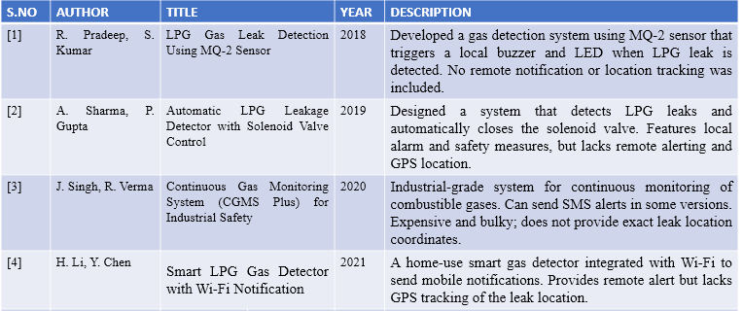
LITERATURE SURVEY

Slide 6
EXISTING SYSTEM
Existing LPG leakage detection systems mainly rely on gas sensors that trigger a local alarm, such as a buzzer or LED indicator, when a leak is detected.
These devices are commonly used in homes, hotels, and industries to warn people nearby, but they work only if someone is physically present to hear or see the alert.
Some advanced systems can connect to automatic shut-off valves or activate exhaust fans, while a few smart-home models send notifications through SMS.
However, most of these systems still do not provide real-time GPS location information, which makes it difficult to identify the exact place of the leak in large areas or when the user is away.
This limitation highlights the need for a more advanced system that includes both leak detection and location-based.

Slide 7
PROBLEM STATEMENT
LPG gas is commonly used in homes, hotels, and industries, and even a small leak can lead to dangerous fire accidents. Most existing gas detectors only make a sound when a leak occurs, which is not helpful if no one is nearby to hear the alarm. To prevent such situations, there is a need for a smart system that can detect LPG leakage and immediately send a warning message to the user along with the GPS location of the leak. This helps the user or emergency services respond quickly and avoid major damage or accidents.

Slide 8
PROPOSED SYSTEM
The proposed system is a compact, smart LPG leakage detector that combines a gas sensor, GPS module, and wireless communication to provide real-time alerts with precise location information.
The gas sensor continuously monitors LPG concentration and, when a dangerous level is detected, the system captures the device’s GPS coordinates and time stamp, sounds a local alarm (buzzer/LED), and sends an immediate notification to the owner or monitoring service via Wi-Fi or GSM/SMS.
The device can also trigger safety actions such as closing an electric solenoid valve or logging the event to a cloud server for later review.
Designed to be portable and low-cost, the system aims to improve response time and safety by ensuring that leak alerts are received even when no one is physically present at the site.

Slide 9
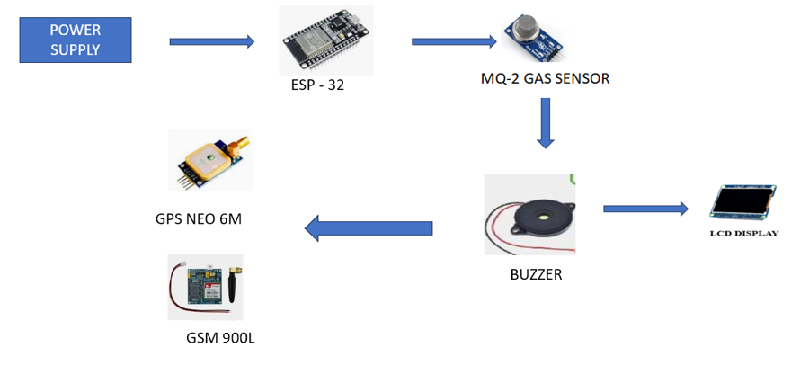
BLOCK DIAGRAM

Slide 10
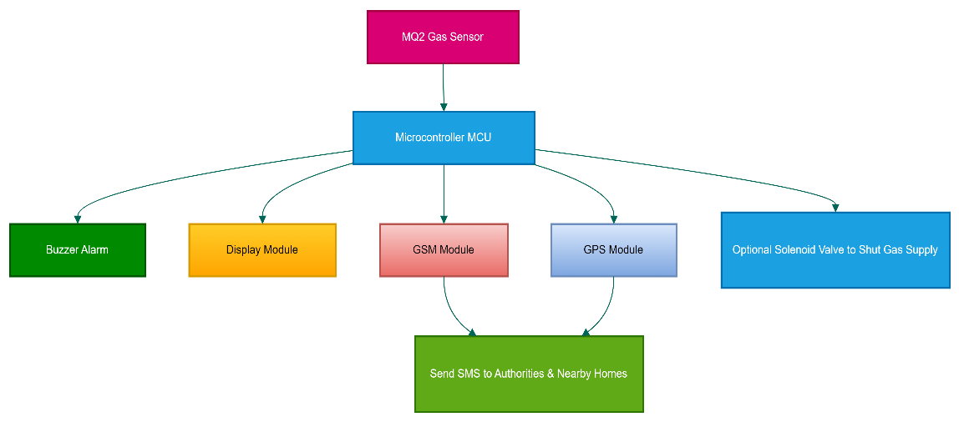
FLOWCHART

Slide 11
HARDWARE USED
MQ-2 Gas Sensor – Detects the presence and concentration of LPG gas in the air.
ESP32 – Acts as the main controller to read sensor values, process data, and send alerts.
GPS Module Neo-6M – Provides real-time location coordinates when a gas leak is detected.
GSM Module SIM900) – Sends SMS and CALL alerts notifications to the user.
Buzzer – Produces a loud alarm during gas leakage.
LED Indicators – Shows system status such as power, connection, or leak detection.
Power Supply 12V – Provides power to the controller and modules.
Connecting Wires and Breadboard – Used for building and testing the circuit.

Slide 12
SOFTWARE USED
Arduino IDE Used to write, compile, and upload the program to the ESP32 microcontroller.
Embedded C / C++ Programming language used to develop the system logic and sensor interface.
ESP32 Board Manager (in Arduino IDE) Required to support ESP32 programming and library installation.
Circuit Designer Used for simulating circuits, sensors, and testing the system virtually.

Slide 13
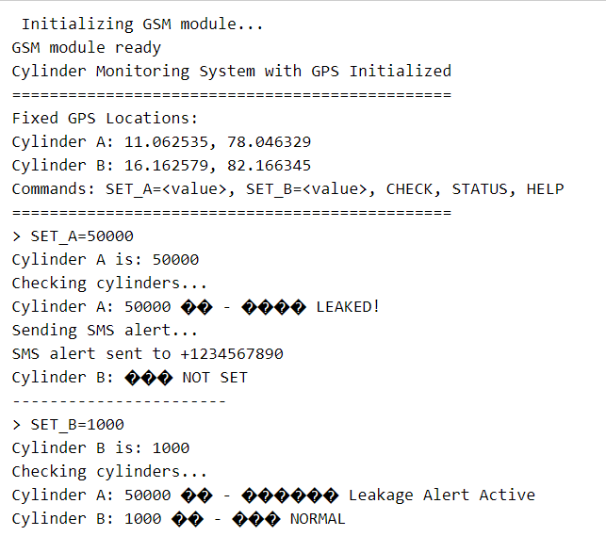
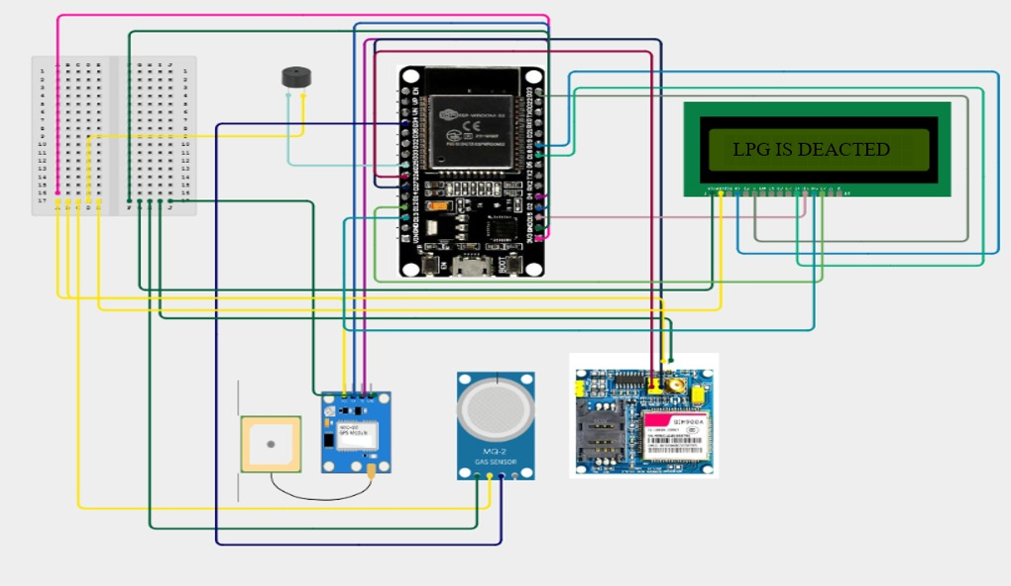
SIMULATION RESULTS

Slide 14
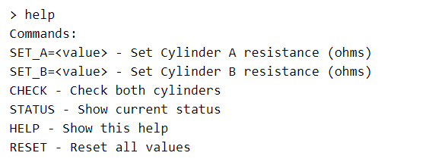
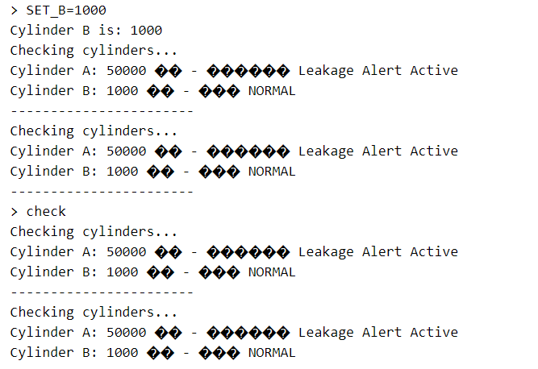
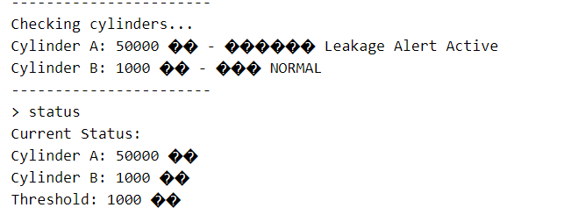
SIMULATION RESULTS

Slide 15
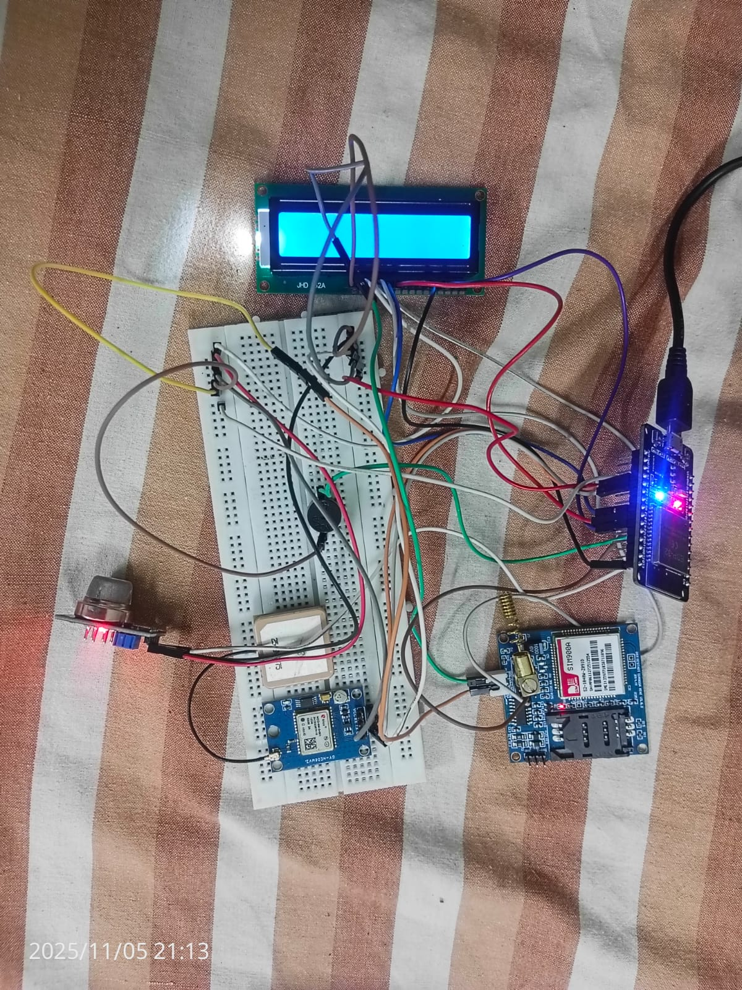
HARDWARE PROTOTYPE

Slide 16
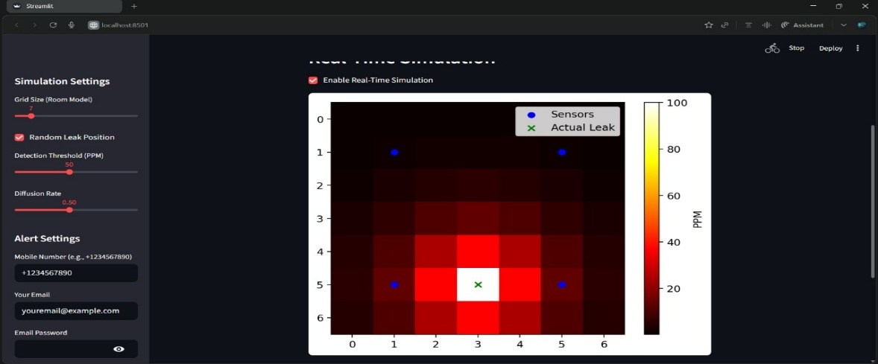
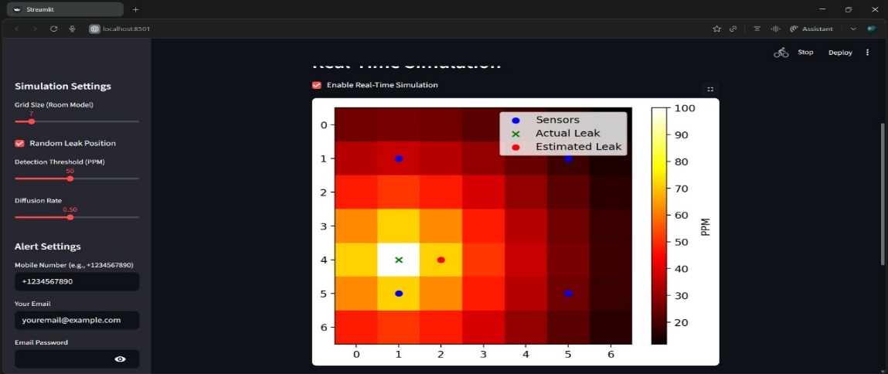
RESULTS
RESULT IN GAS LEAK
RESULT IN GAS LEAK AND ESTIMATED LEAK

Slide 17
DISCUSSION
The GPS Based LPG Leakage Notification System is designed to detect gas leaks quickly and alert users before any danger occurs. The images show a simulation of how LPG spreads inside a room and how sensors placed at different positions sense the gas levels. The colored heatmap represents the gas concentration, where brighter colors mean more gas and darker colors mean less. The green mark shows the actual place where the leak happens, and the red mark in the second image shows the system’s estimated leak location based on sensor readings. This simulation helps us understand how the system works in real life: when gas levels rise above a safe limit, the system immediately sends an alert with the user’s GPS location, ensuring quick action and improved safety.

Slide 18
APPLICATIONS
Used in homes, apartments, and kitchens to prevent fire accidents.
Suitable for hotels, restaurants, and commercial cooking areas.
Can be installed in gas stations, LPG storage units, and industrial plants.
Useful for smart home automation and IoT safety systems.
Deployed in transport vehicles carrying LPG cylinders for live monitoring.

Slide 19
ADVANTAGES
Real-time detection of LPG leakage using MQ-2 sensor.
Sends instant SMS, call alerts, and location using GSM & GPS.
Provides accurate leak location for quick emergency response.
Low-cost, portable, and easy to install and maintain.
Enhances safety, prevents accidents, and protects life and property.
Works even when the user is far away, improving reliability.

Slide 20
LIMITATIONS
Sensor accuracy may be affected by humidity, dust, and airflow conditions.
GSM signals may be weak in remote or underground areas, causing delay.
GPS location may be inaccurate in indoor or closed spaces.
Requires a stable power supply or battery backup to function continuously.
The system may generate false alarms if not properly calibrated.

Slide 21

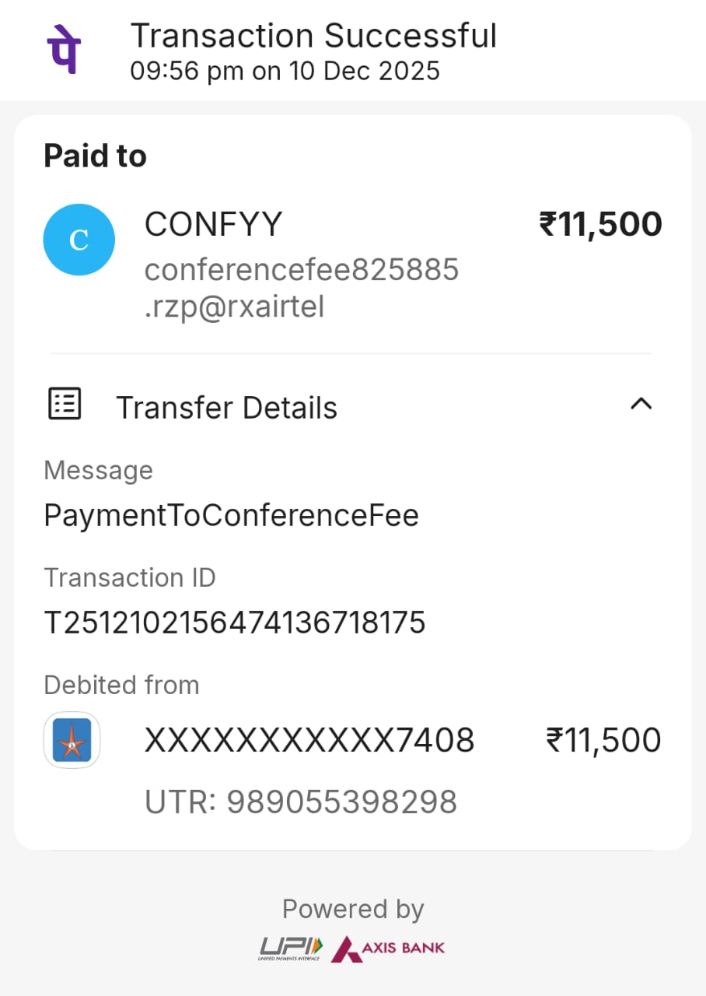
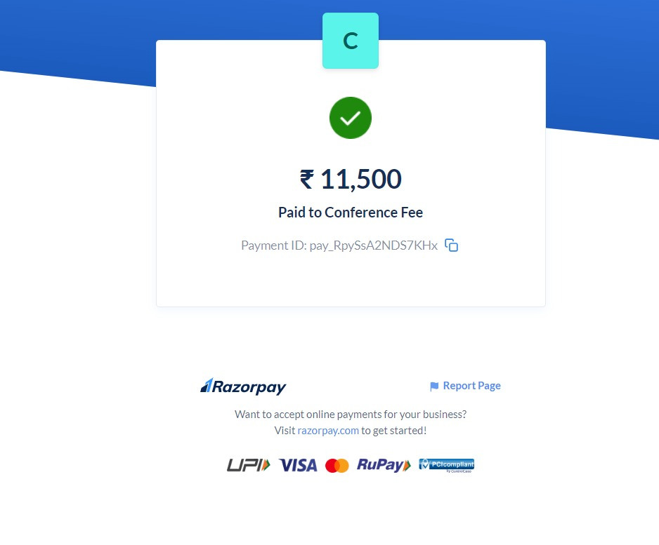
OUTCOME
ACCEPTANCE LETTER
PAYMENT PROOF

Slide 22
FUTURE SCOPE
The proposed LPG leakage detection system can be further improved by integrating cloud-based IoT platforms for real-time data logging, remote monitoring, and long-term safety analytics. Mobile applications can be developed to provide instant alerts, system status, and historical data directly to users’ smartphones. The system can be enhanced with automatic gas valve shut-off mechanisms to immediately stop leakage at its source. AI-based prediction models can be added to analyze gas levels and predict potential leakage risks before they occur. Additional sensors such as temperature and smoke detectors can be included to create a complete multi-hazard safety system. The device can also be made more compact, power-efficient, and battery-operated for improved portability and reliability during power failures. With further development, the system can be integrated into smart home and industrial automation networks to build a fully intelligent safety infrastructure.

Slide 23
CONCLUSION
The GPS-based LPG Leakage Notification System provides an effective solution for detecting dangerous gas leaks and alerting users in real time. By combining a gas sensor with GPS tracking and wireless communication, the system ensures that the exact location of a leak is immediately known, allowing quick action to prevent accidents. It not only triggers local alarms like buzzers and LEDs but also sends notifications via Wi-Fi or GSM, making it useful even when the user is away. This smart system improves safety in homes, industries, and commercial spaces, reduces the risk of fire accidents, and offers a reliable, low-cost, and easy-to-use solution for LPG leak detection.

Slide 24
REFERENCE
Rachana S, Pavitra D.R, Smayana N.P, M.G. Veena, "Sentinel LPG Leakage Detection System with Automatic Regulator", 2025 IEEE International Conference on Interdisciplinary Approaches in Technology and Management for Social Innovation (IATMSI), vol.3, pp.1-5, 2025.
Kavitha D, Rajavarshini R U, Nivedha J, Ragavi R, Sumathi S, "IoT-Enabled Proactive LPG gas Surveillance and Alert System", 2025 International Conference on Computing and Communication Technologies (ICCCT), pp.1-6, 2025.
Ahmed, Saad, Md Jubayer Rahman, and Md Abdur Razzak. “Design and Development of an IoT -Based LPG Gas Leakage Detector for Households and Industries.” 2023 IEEE World AI IoT Congress (AIIoT). IEEE, 2023.
Mayur Shinde, Harshal Pawar, Mayank Sethiya, Vibhavari Joshi, Chaitanya Joshi, Pallavi Deshpande, "CNG/LPG Gas Leakage Accident Prevention System", 2024 3rd International Conference on Automation, Computing and Renewable Systems (ICACRS), pp.262-267, 2024.

